Slide 1
WordMan
Muskan – 151369
Vasudha Pandey – 151404
Anirudh Sharma – 151363
Ayushmat Bhardwaj Soni – 151420
Himanshu Chauhan – 151412
Prateek Ramani - 151464

Slide 2
Abstract
In the present rationally rushed world, we get so captivated in making a living that we almost disregard to respect the real supports in our lives - our loved ones.
WordMan is focused on giving you the most ideal computerized welcome and wish your friends and family joy and love
Our group of specialists comprehend the difference of human feelings and spend innumerable hours in assembling keen messages that help you express your sentiments to your friends and family.

Slide 3
Introduction
We all seem to be very curious about the occasions that we come across our daily life, excited about wishing our near and dear ones sometimes it is difficult to figure out the messages we need to send to them.
In this application the guest user can view the messages but cannot download it.
Only the registered user can download the message and can access the whole website after successful subscription.
The website requires the admin to control all the backend functionalities.

Slide 4
Technologies Used
Language -C#, Sql Server
Entity Framework
.NET Framework
Visual Studio
ASP .NET MVC
SSMS

Slide 5
Requirements
Registration
Only the registered user can access all the user functionalities.
User has to provide their full name, address etc. while registering
Messages can be downloaded by the logged in user
An admin part can be there for managing the services and users

Slide 6
User
User can register using registration page.
Edit his/her profile.
Login by necessary credentials.
View homepage.
View Categories.
View Messages.
Download depending upon the user type.
Give feedback.
Use payment portal to make payments.
Select the desired messages and templates.
Can see top rated messages and number of downloads

Slide 7
Admin
Admin can Add, Edit, Delete a Category.
Admin can Add, Edit, Delete a Message.
Admin can Add, Edit, Delete a Template.
Admin can view feedback, modify about us and contact us pages.

Slide 8
EXTRA REQUIREMENTS Payment gateway Downloading messages Ratings. USER INTERFACE Should be easy to understand and user friendly. Should adapt to different screen sizes.

Slide 9
Database (Tables Used)
The database of the application consists of the following tables:
User
Roles
Card Details
Template
Categories
Messages
Rating
Feedback

Slide 10
Implementation Of Database
While making MVC application, we need to decide the type of development approaches. There are basically types of development approaches that are:
Database-first Approach
Code-first Approach
Code-first using an existing database Approach
In WordMan application, we have used the first approach that is Database-First Approach to further implement data access layer for the application.
In Database-first approach(also called Reverse Engineering), the tables of the existing database are converted into C# classes representing database tables(entities) and the relationship between them(data model).

Slide 11
Data Access Layer
The Data Access Layer of an MVC application consists of all the backend functionalities which are to be performed and showed on user interface.
Database-first approach is achieved using scaffolding.
Scaffolding is performed by using the command Scaffold-DbContext. This command when executed with necessary database details, generates the Entity Data Model.
Syntax:
Scaffold-DbContext -Connection "Data Source =server_name;Initial Catalog=database_name;Integrated Security=true" -Provider Microsoft.EntityFrameworkCore.SqlServer -OutputDir o/p_folder_name

Slide 12
Scaffolding command includes the connection string which is used to establish a secure connection with the database which is already implemented.
The provider string provides the database provider name which contains all the runtime libraries required to communicate with the database.

Slide 13
Data Access Layer operations (Repository class)
GetCategories()
GetRelationships()
GetAllMessages()
AddCategory()
GetMessageOnCategoryId()
AddMessage()
UpdateCategory()
AddFeedBack()
RegisterUser()
EditUserProfile()

Slide 14
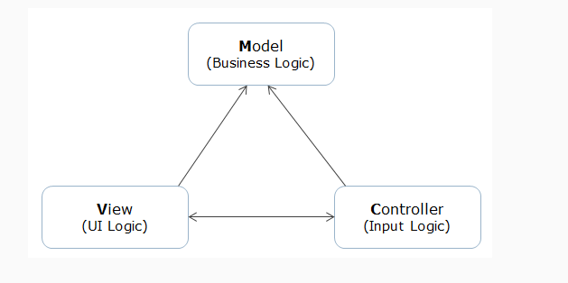
Model View Controller(MVC)
An architectural design pattern used for enterprise application development.
It separates different aspects of the applications (input logic, business logic, and UI logic), while providing a loose coupling between these elements.

Slide 15
Controller
In this class, a parametrized constructor is made and in that two parameters are passed: Object of Word Man Repository class and second is the object of IMapper class. IMapper class helps in mapping the entities of data access layer and MVC models with each other.
There are in total 4 controllers used in the project which are listed below:
Admin Controller
Guest Controller
Home Controller
User Controller

Slide 16
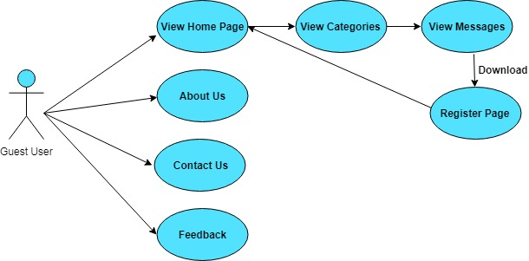
User Case Diagrams
Guest User

Slide 17
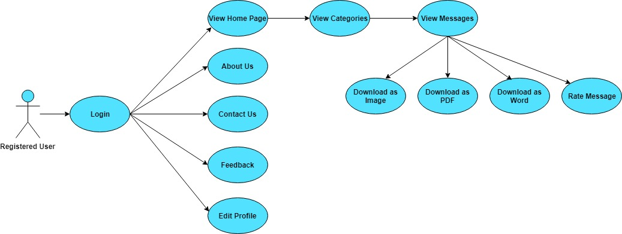
Register User

Slide 18
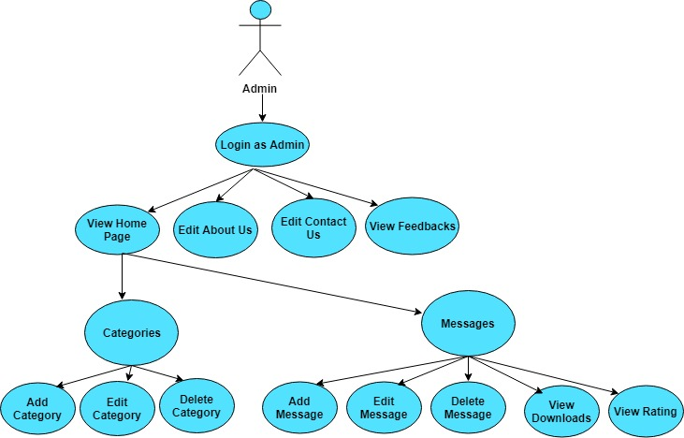
Admin

Slide 19
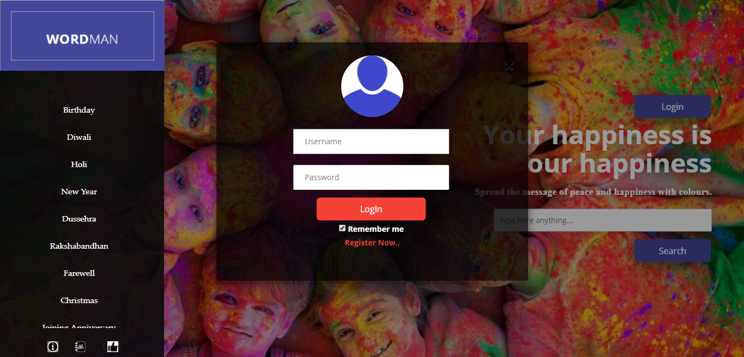
Screenshots: Login Page

Slide 20
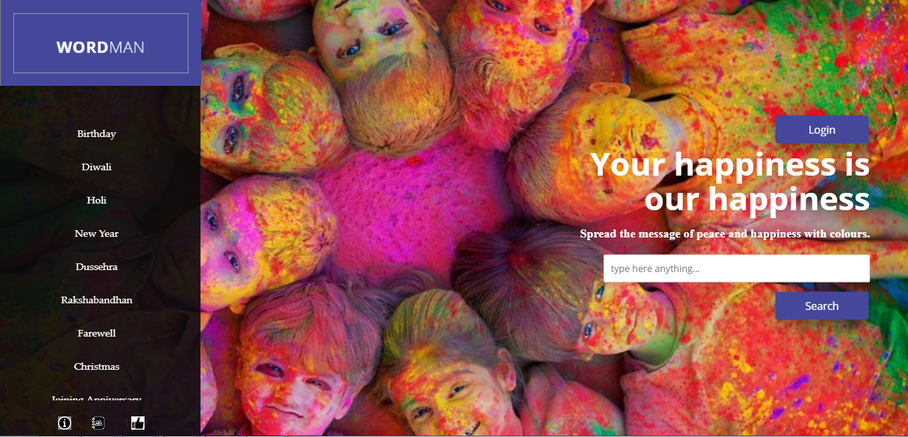
Homepage

Slide 21
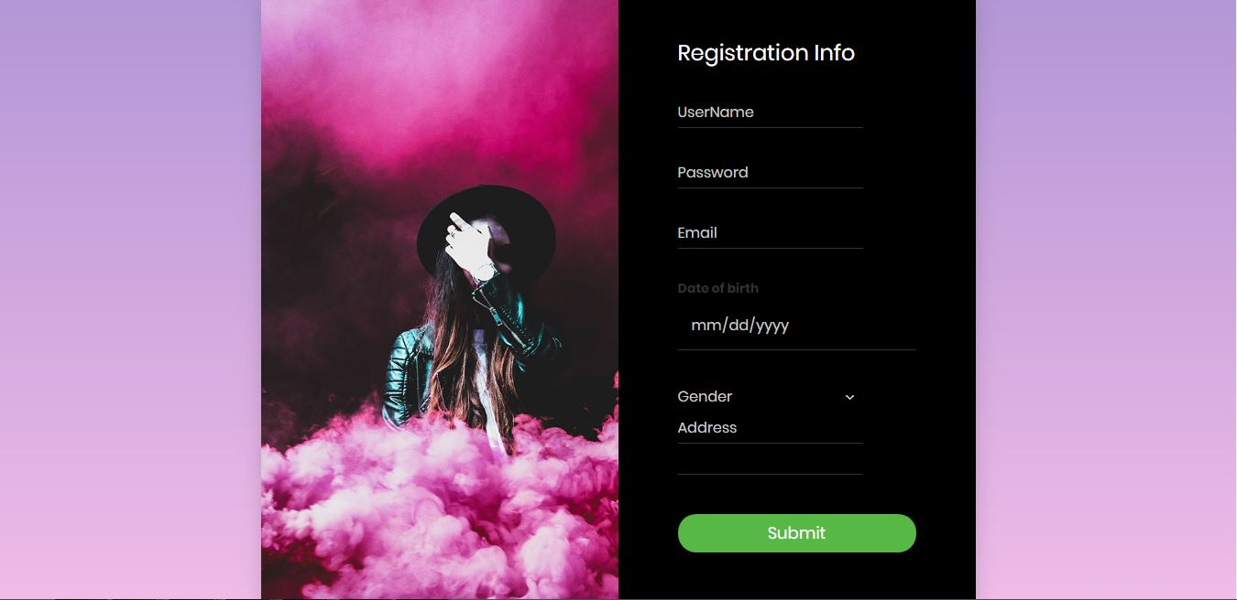
Register User

Slide 22
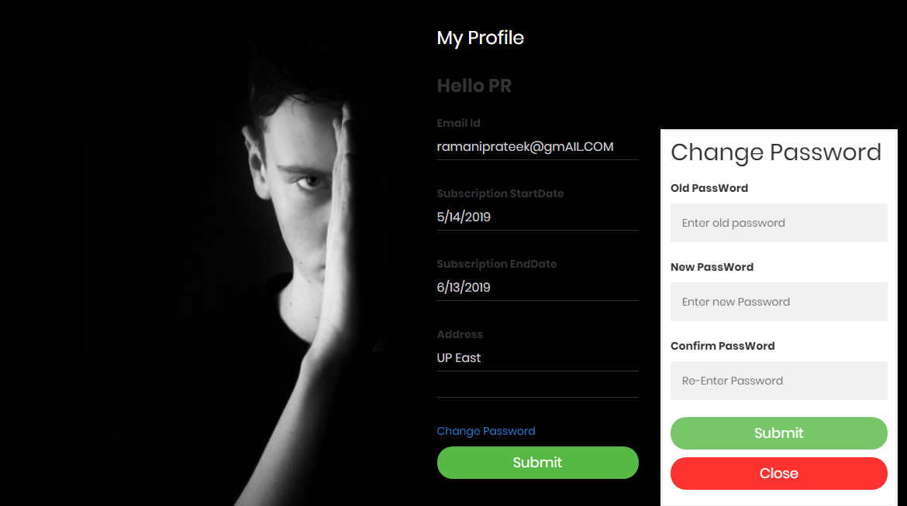
Edit Profile

Slide 23
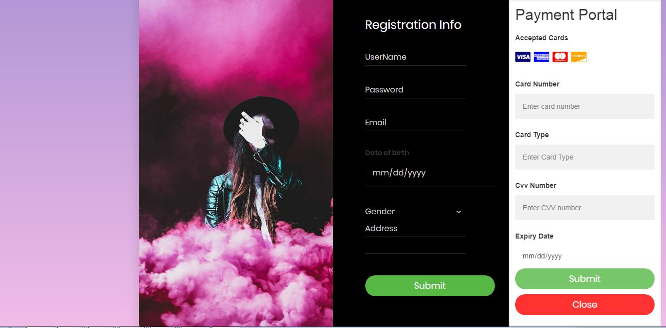
Payment Portal

Slide 24
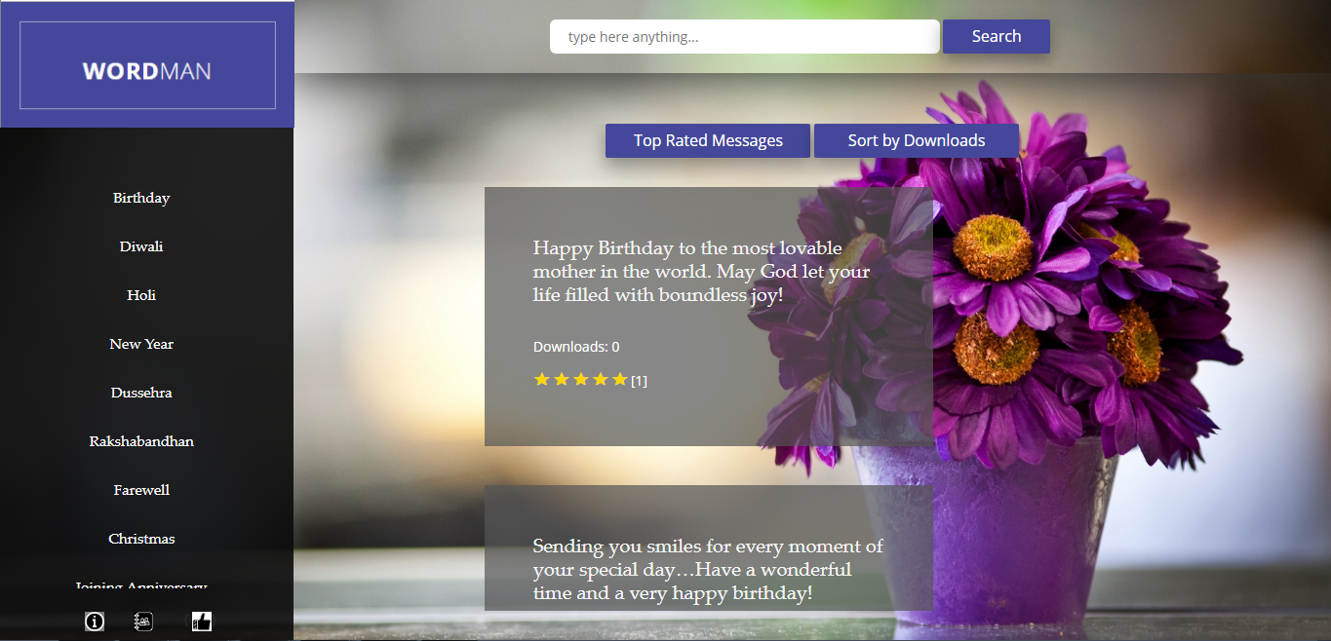
View Messages

Slide 25
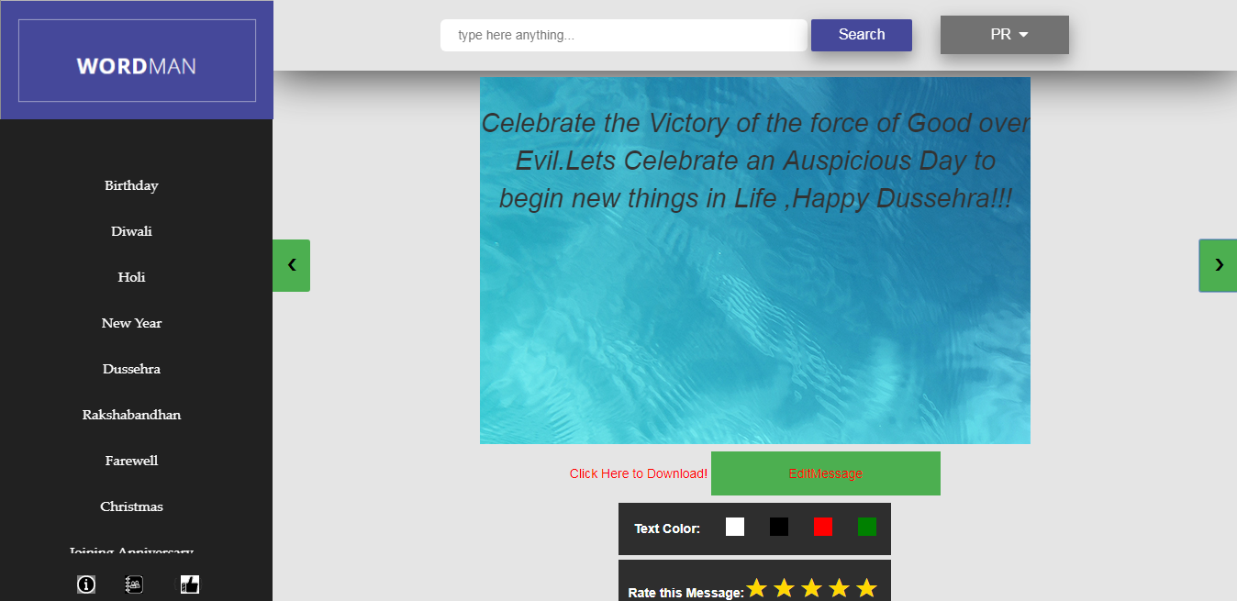
Templates

Slide 26
Performance analysis
SI: No: | Condition to be tested | Expected Result | Pass/Fail
1 | Empty message stored | Message Displayed: Field cannot be empty | P
2 | Category Name is Empty. | Message Displayed: Stored Field cannot be empty. | P
3 | Edit name and put blank spaces | Message Displayed: Field cannot be empty. | P
4 | Delete category which is already existing | Message Displayed: Stored Cannot be deleted, foreign key reference. | P

Slide 27
Sl: No: | Condition to be tested | Expected Result | Pass/Fail
1 | Feedback empty. | Message Displayed: Message cannot be empty | P
2 | Email id empty | Message Displayed: Field cannot be empty | P
3 | Email format is incorrect | Message Displayed: Invalid email id entered | P
4 | Name empty. | Message Displayed: Name cannot be empty | P
Sl: No: | Condition to be tested | Expected Result | Passed/Fail
1 | User name is entered as blank spaces. | Message Displayed: Enter valid user name | P
2 | DOB is Incorrect | Message Displayed: Enter valid DOB | P
3 | Password is entered as blank spaces. | Message Displayed: Please enter any other password | P
4 | Any Field left empty | Message Displayed: Field cannot be left empty | P

Slide 28
Conclusion
Reduction errors due to human intervention
User friendly
Flexible for further enhancement
All users and services on one platform
Easy, convenient and efficient for finding greetings .
Ease in information retrieval

Slide 29
Future Scope
Using better algorithms for searching the message.
Artificial intelligence for generating new message instead of giving suggestions from previously stored messages.
Use of machine learning to predict what the user expect from the application.
Better user interface can be included to make the application more interactive.
Better templates and better customization options for user.

Slide 30
References Books [1] Professional ASP.NET MVC 5 [2] Book by Brad Wilson, David Matson, Jon Galloway, and K. Scott Allen Website [3] https://docs.microsoft.com/en-us/dotnet/index [4] https://docs.microsoft.com/en-us/aspnet/mvc/mvc5 [5] https://www.tutorialspoint.com/csharp/ [6] https://www.microsoft.com/en-us/sql-server/sql-server-2016 [7] http://stackoverflow.com/ [8] https://lex.infosysapps.com/login

